Slide 1
HISTOLOGY OF
CARDIOVASCULAR SYSTEM
Lecture 3 (1st Week)
Block 206 CVS
Prepared by
Prof./Ola Abd El Tawab
Professor of Histology- Faculty of Medicine- Assiut University
Histology Department
2021-2022

Slide 2
Learning objectives (1st week/Lecture 1)
After the lecture, students should be able to:
▪ Recognize the different parts of the heart.
▪ List the names of layers of cardiac wall, (Epicardium, pericardium, endocardium).
▪ Discuss the normal structure of cardiac skeleton and cardiac valves.
▪ Describe the normal structure of intercalated disc.
▪ Identify and describe the structure of Purkinje muscle fibers.

Slide 3
Histology of the heart
The histology of the cardiovascular system plays the main role in its function. The cardiovascular system consists of the heart, arteries, microvascular bed, veins and lymphatic vessels. These components have the main role to exchange oxygen, carbon dioxide, metabolites, salts, water and metabolic waste products.

Slide 4
Histology of the heart:
The heart wall can be divided into three layers:
(1) The endocardium : Innermost layer of the heart (lines the atria and ventricles and covers the heart valves) and contains blood vessels.
Has 3 sublayers:
  Endothelium - innermost portion is a simple squamous epithelium.
  Smooth Muscle and Connective Tissue - middle layer of the endocardium is mix of connective tissue and smooth muscle.
  Sub endocardial Layer - outer layer of the endocardium is loose connective tissue joining the endocardium and myocardium.
equivalent to tunica intima.

Slide 5
(2) The myocardium : Middle layer of the heart, thickest layer contains cardio myocytes and blood vessels.
* Contains cardiac muscle fibers and loose endomysial connective tissue containing many capillaries.
Muscular layer.
equivalent to tunica media.
(3) The epicardium :
* Outer layer of the heart, contains blood vessels , lymphatics (visceral layer of the pericardium) .
* Fibro elastic connective tissue, blood vessels, lymphatics and adipose tissue and covered by simple squamous epithelium (called mesothelium).
Visceral layer of pericardium rather thin.
Equivalent to tunica adventitia.

Slide 6
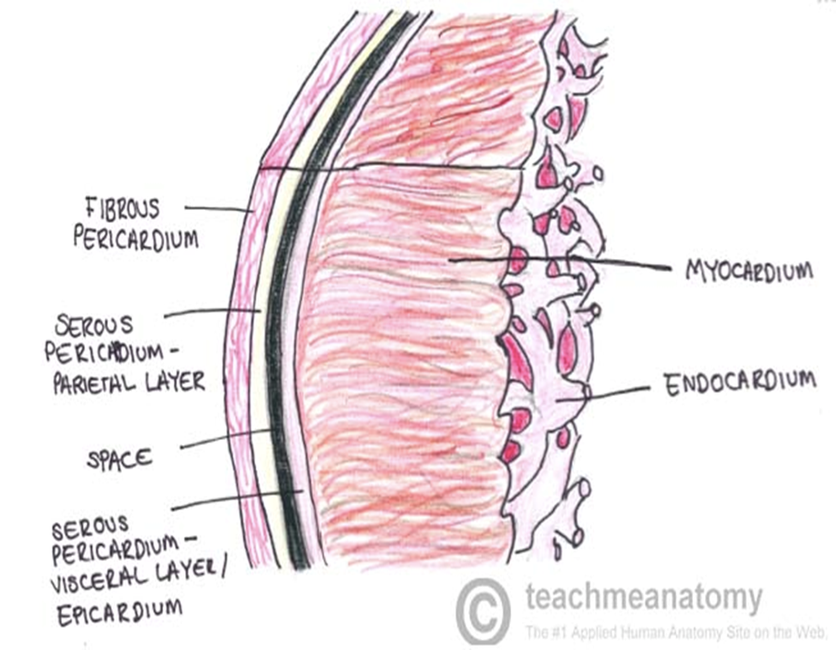

Slide 7
The mammalian heart has four chambers, two thin-walled atria and two thicker-walled ventricles.
Cardiac skeleton :
The central supporting structure of the heart is the "cardiac skeleton," composed of dense white fibrous (collagenous) connective tissue into which the cardiac muscle fibers of the atria and ventricles insert and to which the heart valves are attached. In some species, these fibrous rings have a cartilage-like appearance. This skeleton provides structure and support for the heart, as well as isolating the atria from the ventricles.

Slide 8
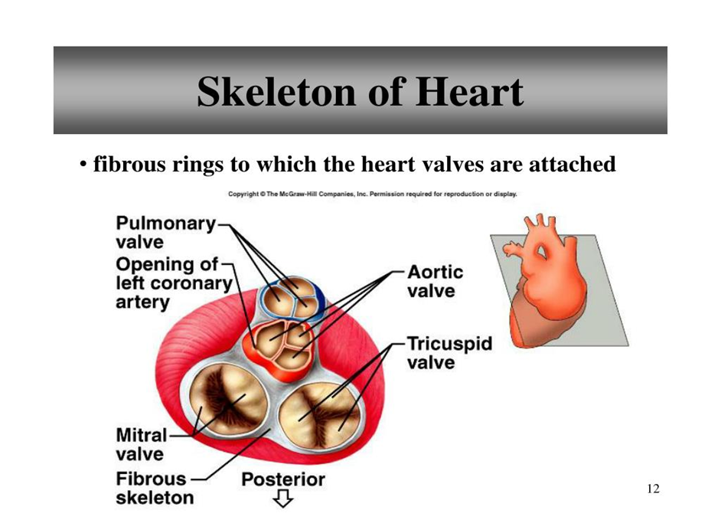

Slide 9
Cardiac valves:
The orifices of the four chambers are guarded by valves, which are endocardial folds supported by internal plates of dense collagenous and elastic connective tissue continuous with the cardiac skeleton. The right atrioventricular valve has three cusps; hence, it is called the tricuspid valve. The left atrioventricular valve has two cusps and is called the bicuspid, or mitral valve. Semilunar valves located at the ventricular entrance to the aorta and pulmonary arteries have three cusps each. The valves are arranged to prevent retrograde or reverse blood flow. The innermost part of the valves is continuous with the fibrous rings. The atrioventricular valves have connective tissue extensions, the chordae tendinea, which connect to muscular extensions of the inner heart wall called papillary muscles.

Slide 10
Purkinje fibers :
Modified cardiac muscle cells and larger than ordinary cardiac muscle with fewer myofibrils and many mitochondria .
Compared to ordinary cardiac muscle cells:
  Contain large amounts of glycogen.
  Fewer myofibrils. * Thicker cells.
Can be binucleated (cell contains 2 nuclei).
Extend from the atrioventricular node, pierces the fibrous body, divides into left and right bundles, and travels, beneath the endocardium, towards the apex of the heart.
Bundle branches contact cardiac muscle cells through specializations similar to intercalated discs.
Conduct stimuli faster than ordinary cardiac muscle cells .
Discovered in 1839 by Jan Evangelista Purkynjě).

Slide 11
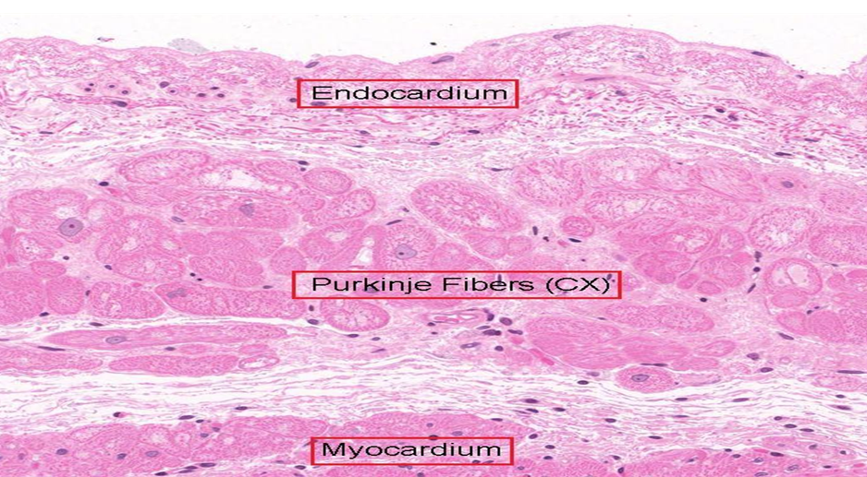

Slide 12
Intercalated disc :
These are the specialized junctions of cell membranes of adjacent cardio myocytes. They extend across the fiber at the level of the Z lines in a stepwise manner.
Two regions can be distinguished in the intercalated discs:
Transverse portion that runs across the fibers perpendicular to the myofilaments and lies at the level of the Z line. It is formed of fascia adherens (similar to zonula adherens) and many desmosomes (similar to those of epithelium but attached through desmin intermediate filaments) to provide strong adhesion between the adjacent cardio myocytes.
The longitudinal portion runs parallel to the myofilaments with many gap junctions to allow rapid spread of excitation between the adjacent cardio myocytes.

Slide 13
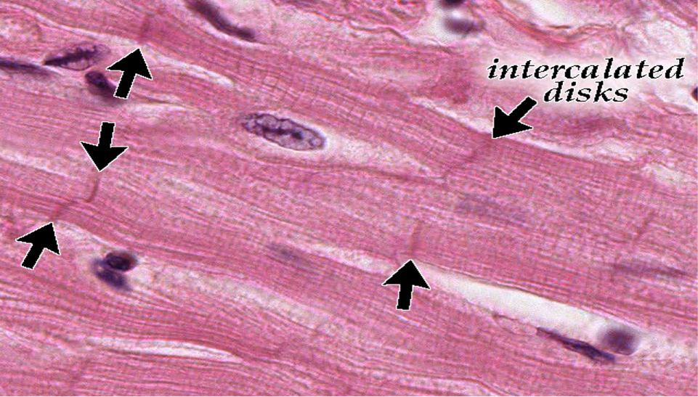

Slide 14
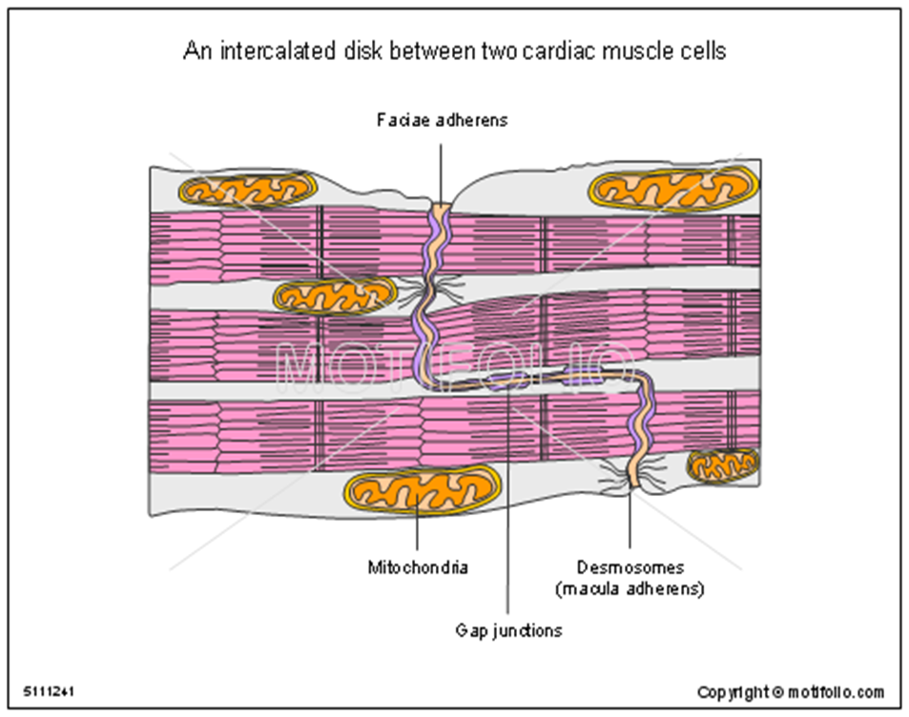

Slide 15
Self Assessment of Lecture 3
I- Complete the missing words:
1. Purkinjue fibers are …Larger….. than ordinary muscle fibers. The bulk of the sarcoplasm is occupied by Glycogen and Mitochondria
2. Valves, are endocardial folds supported by internal plates of … dense collagenous and elastic connective tissue that continuous with the cardiac skeleton.
II- Answer with true (T) or false (F):
1. Cardiac skeleton composed of dense yellow elastic connective tissue into which the cardiac muscle fibers of the atria and ventricles. ( F )
2. Fascia adherence are anchoring sites for actin, that prevent separation during contraction by binding filaments, joining the cells together ( T )

Slide 16
Choose the correct answer:
1- What is the innermost layer of the heart wall?
A. Epicardium.
B. Pericardium.
C. Visceral pericardium.
D. Endocardium.
2- What is the name of the valve between the left atrium and left ventricle?
A. Mitral valve.
B- Tricuspid valve.
C- Semilunar valve.
D - Aortic valve.
3- Purkinje fibers are located in which of the heart layer?
A. Endocardium.
B. Myocardium.
C. Epicardium .
D. Pericardium.

